Slide 1


- In management of epilepsy

Slide 2
Introduction to Epilepsy
Types of seizure
Classification of AEDs
Structures of drugs
Synthesis of some drugs
Management of epilepsy
History of AED therapy
Newer released drugs
References

Slide 3
Neurological disorder
Abnormal signalling of neurons
Disturbed neuronal activity
Strange sensations,emotions,behaviour
Convulsions,muscle spasms
Loss of conciousness

Slide 4
PARTIAL SEIZURES :
Localized within a focal area of the brain
Convulsions confined to a single limb,muscle group,specific localized sensory disturbances
Without impairment of consciousness GENERALIZED SIEZURES :
Imparts unconsciousness
Grand mal
Petit mal
UNDETERMINED SEIZURES :
Neonatal seizure
SITUATION RELATED SEIZURES :
Toxic events due to alcohol,drugs etc.

Slide 5

BARBITURATES :
eg: Phenobarbital, Mephobarbital
HYDANTOIN DERIVATIVES :
eg: Phenytoin, Phenylethyl hydantoin
OXAZOLIDINEDIONE DERIVATIVES : eg: Trimethadione, Paramethadione
SUCCINIMIDES :
eg: Phensuximide, methsuximide
BENZODIAZEPINES :
eg: Diazepam, Clobazepam
GABA ANALOGUES : eg: Progabide, Tiagabin

Slide 6
MISCELLANEOUS :
eg: Carbamazepine, Valproate
NEWER ANTICONVULSANTS : eg: Denzimol, Denzinamide

Slide 7
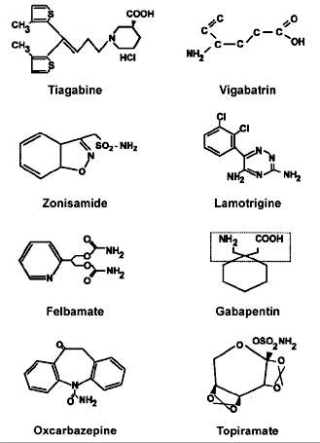

Slide 8
 Carbamazepine:

Slide 9
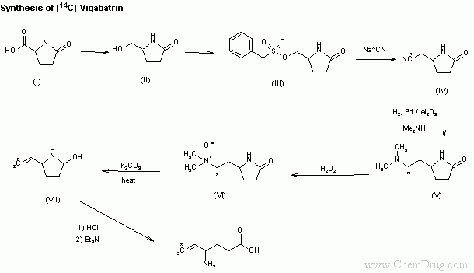
VIGABATRIN

Slide 10

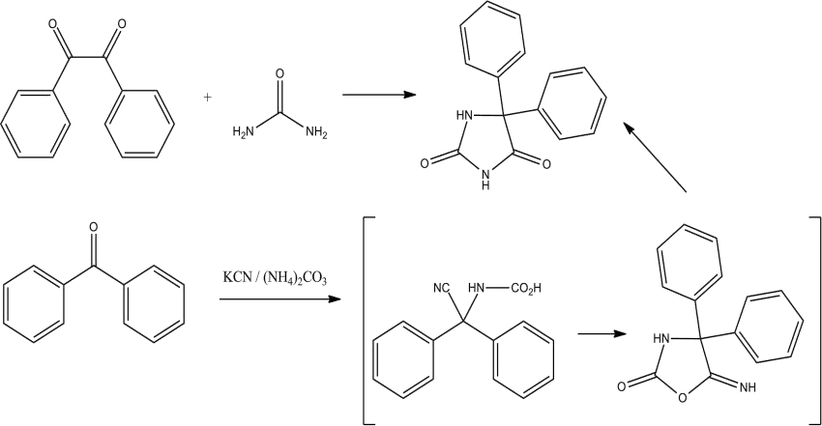

Slide 11
Modulation of voltage gated ion channels:
(sodium and calcium channel inhibitors)
-carbamazepine
-phenytoin
-ethosuximide
Enhancement of synaptic inhibition :
( GABA activity)
-benzodiazepines
Inhibition of synaptic excitation :
( Glutamate activity)
-vigabatrin

Slide 12

 Partial seizures
Carbamazepine, Phenytoin, Phenobarbitone,Valproate
Ethosuximide, Valproate
Clonazepam, Phenobarbital, Primidone
Diazepam,Lorazepam followed by Phenytoin, Fosphenytoin
 Generalized seizures
 Status epilecticus
DISORDER
PRIMARY AGENTS(S)

Slide 13
1857-Bromides
1912-Phenobarbitone
1937-Phenytoin
1944-Trimethadione
1960-Ethosuximide
1974-Carbamazepine
1975-Clonazepam
1978-Valproate
1990-Oxcarbaepine
1993-Felbamate,Gabapentin
1995-Lamotrigmine
1997-Topiramate, Tiagabin

Slide 14
Zonisamide-2000
Pregabalin-2008
Lacosamide-2008
Eslicarbazepine-2009
Retigabine-2011

Slide 15



1. Hauser WA, Annegers JF, Kurland LT.Incidence of epilepsy and unprovoked seizures in Rochester, Minnesota: 1935-1984.Epilepsia 1993;34:453-68.
2. Idem. Prevalence of epilepsy in Rochester,Minnesota: 1940-1980.
Epilepsia1991;32:429-45.
3. Annegers JF, Dubinsky S, Coan SP,Newmark ME, Roht L. The incidence of epilepsy and unprovoked seizures in multiethnic,urban health maintenance organizations.Epilepsia 1999;40:502-6.
4. Banerjee PN, Hauser WA. Incidence and prevalence. In: Engel J Jr, Pedley TA, eds. Epilepsy: a comprehensive textbook. 2nd ed.
Baltimore: Wolters Kluwer/Lippincott Williams & Wilkins, 2008:45-56.
5. Cloyd J, Hauser W, Towne A, et al. Epidemiological and medical aspects of epilepsy in the elderly. Epilepsy Res 2006;
68:Suppl 1:S39-S48.

Slide 16


