Slide 1
ANTIEPILEPTIC DRUGS

Slide 2
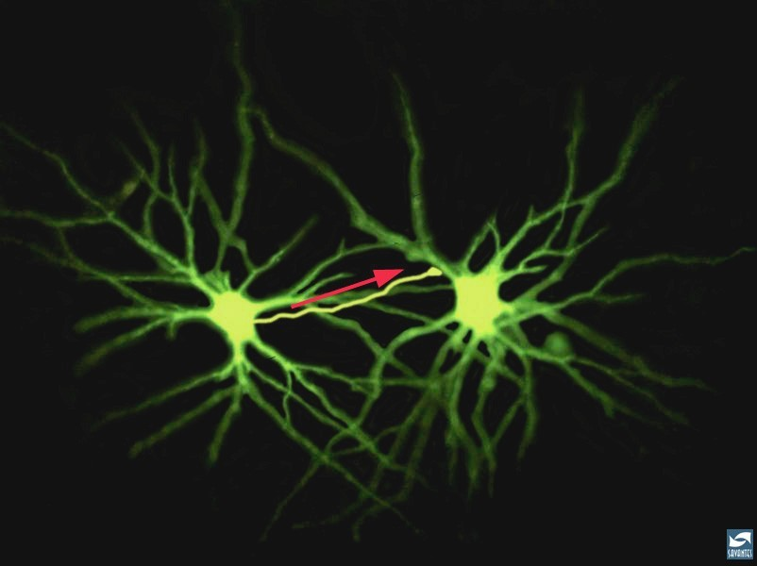
Epilepsy
A group of chronic CNS disorders characterized by recurrent seizures.
Seizures are sudden, transitory, and uncontrolled episodes of brain dysfunction resulting from abnormal discharge of neuronal cells with associated motor, sensory or behavioral changes.

Slide 3
Epilepsy
There are 2.5 million Americans with epilepsy in the US alone.
More than 40 forms of epilepsy have been identified.
Therapy is symptomatic in that the majority of drugs prevent seizures, but neither effective prophylaxis or cure is available.

Slide 4
Causes for Acute Seizures
Trauma
Encephalitis
Drugs
Birth trauma
Withdrawal from depressants
Tumor
High fever
Hypoglycemia
Extreme acidosis
Extreme alkalosis Hyponatremia
Hypocalcemia
Idiopathic

Slide 5
Seizures
The causes for seizures can be multiple, from infection, to neoplasms, to head injury. In a few subgroups it is an inherited disorder.
Febrile seizures or seizures caused by meningitis are treated by antiepileptic drugs, although they are not considered epilepsy (unless they develop into chronic seizures).
Seizures may also be caused by acute underlying toxic or metabolic disorders, in which case the therapy should be directed towards the specific abnormality.

Slide 6
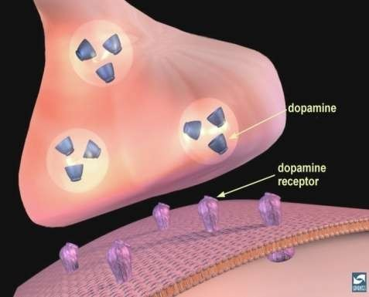
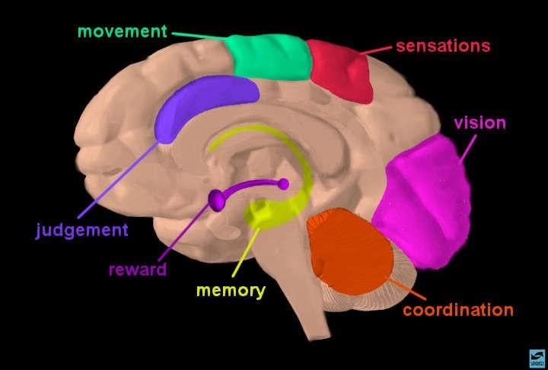



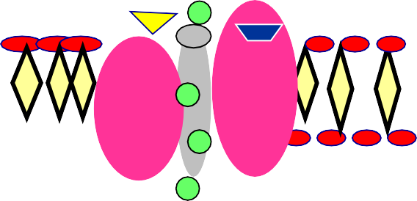
Neuronal Substrates of Epilepsy
The Synapse
ions
The Brain
www.freelivedoctor .com
The Ion Channels/Receptors

Slide 7
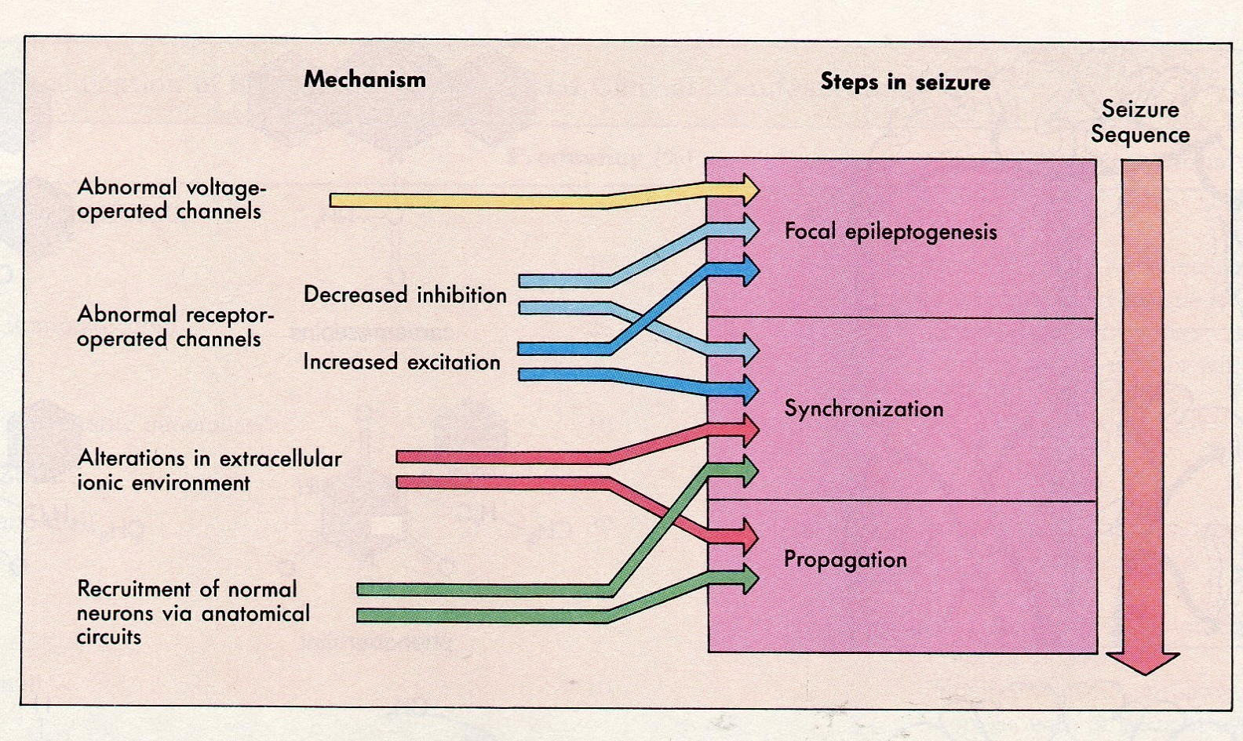
Cellular and Synaptic Mechanisms of Epileptic Seizures
www.freelivedoctor .com
(From Brody et al., 1997)

Slide 8
Classification of Epileptic Seizures
Partial (focal) Seizures
  Simple Partial Seizures
  Complex Partial Seizures
Generalized Seizures
  Generalized Tonic-Clonic Seizures
  Absence Seizures
  Tonic Seizures
  Atonic Seizures
  Clonic and Myoclonic Seizures

Slide 9
I. Partial (Focal) Seizures
Simple Partial Seizures
Complex Partial Seizures.

Slide 10
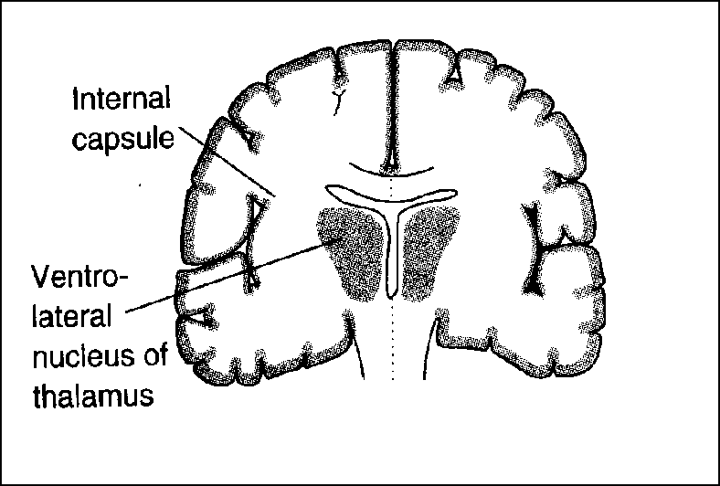
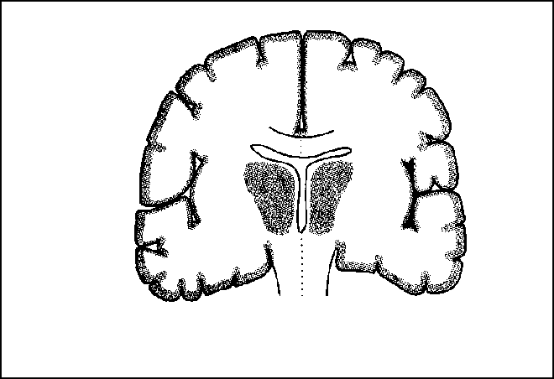
Scheme of Seizure Spread
Simple (Focal) Partial Seizures
^{Contralateral sp}w^{r}w^{e}wª.^{d}freelivedoctor .com

Slide 11
I. Partial (Focal) Seizures
A. Simple Partial Seizures (Jacksonian)
Involves one side of the brain at onset.
Focal w/motor, sensory or speech disturbances.
Confined to a single limb or muscle group.
Seizure-symptoms don’t change during seizure.
No alteration of consciousness.
EEG: Excessive synchronized discharge by a small group of neurons. Contralateral discharge.
www.freelivedoctor .com

Slide 12

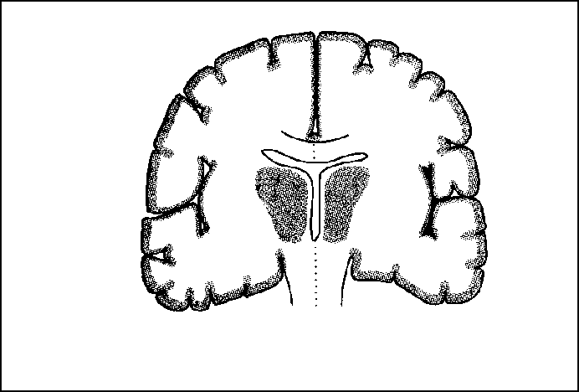


Scheme of Seizure Spread
Complex Partial Seizures
Complex Secondarily Gwwewn.freeerliavedloicztoer .dcomPartial Seizures

Slide 13
I. Partial (focal) Seizures
B. Complex Partial Seizures (Temporal Lobe epilepsy or Psychomotor Seizures)
Produces confusion and inappropriate or dazed behavior.
Motor activity appears as non-reflex actions. Automatisms (repetitive coordinated movements).
Wide variety of clinical manifestations.
Consciousness is impaired or lost.
EEG: Bizarre generalized EEG activity with evidence of anterior temporal lobe focal abnormalities. Bilateral.

Slide 14
II. Generalized Seizures
Generalized Tonic-Clonic Seizures
Absence Seizures
Tonic Seizures
Atonic Seizures
Clonic and Myoclonic Seizures.
Infantile Spasms

Slide 15
II. Generalized Seizures
In Generalized seizures, both hemispheres are widely involved from the outset.
Manifestations of the seizure are determined by the cortical site at which the seizure arises.
Present in 40% of all epileptic Syndromes.

Slide 16
II. Generalized Seizures (con’t)
Generalized Tonic-Clonic Seizures
Recruitment of neurons throughout the cerebrum
Major convulsions, usually with two phases:
  Tonic phase
  Clonic phase
Convulsions: motor manifestations, may or may not be present during seizures, excessive neuronal discharge. Convulsions appear in Simple Partial and Complex Partial Seizures if the focal neuronal discharge includes motor centers; they occur in all Generalized Tonic-Clonic Seizures regardless of the site of origin. Atonic, Akinetic, Absence Seizures are non-convulsive

Slide 17
II. Generalized Seizures (con’t)
A. Generalized Tonic-Clonic Seizures
Tonic phase:
- Sustained powerful muscle contraction (involving all body musculature) which arrests ventilation.
EEG: Rythmic high frequency, high voltage discharges with cortical neurons undergoing sustained depolarization, with protracted trains of action potentials.

Slide 18
II. Generalized Seizures (con’t)
A. Generalized Tonic-Clonic Seizures
Clonic phase:
- Alternating contraction and relaxation, causing a reciprocating movement which could be bilaterally symmetrical or “running” movements.
EEG: Characterized by groups of spikes on the EEG and periodic neuronal depolarizations with clusters of action potentials.

Slide 19
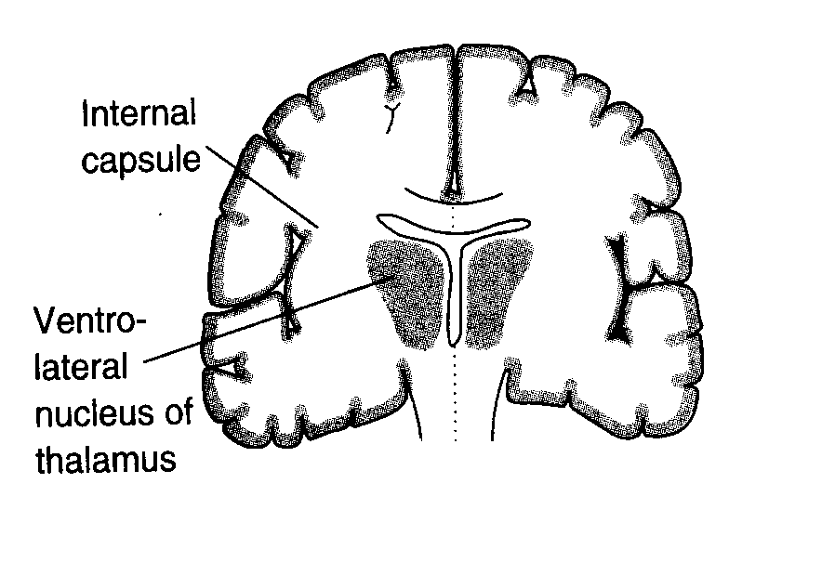
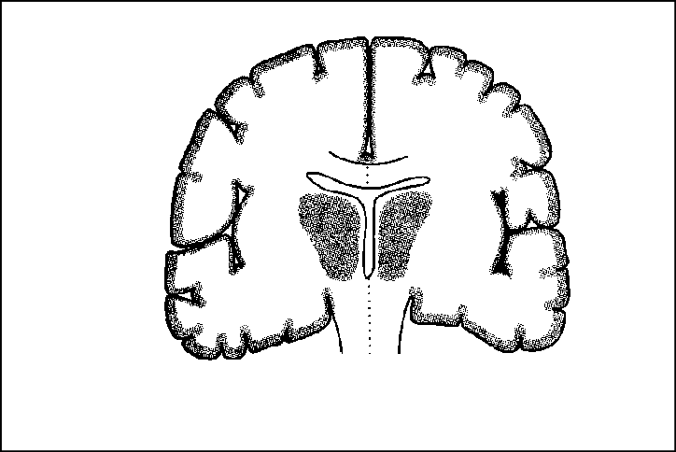




Scheme of Seizure Spread
Generalized Tonic-Clonic Seizures
Both hemispheres are
www.freelivedoctor .cominvolved from outset

Slide 20
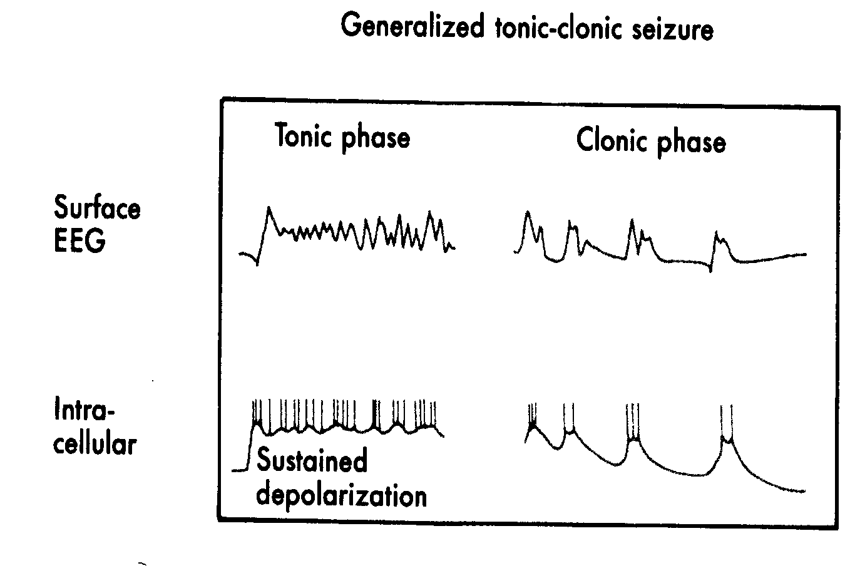
Neuronal Correlates of Paroxysmal Discharges
Generalized Seizures

Slide 21
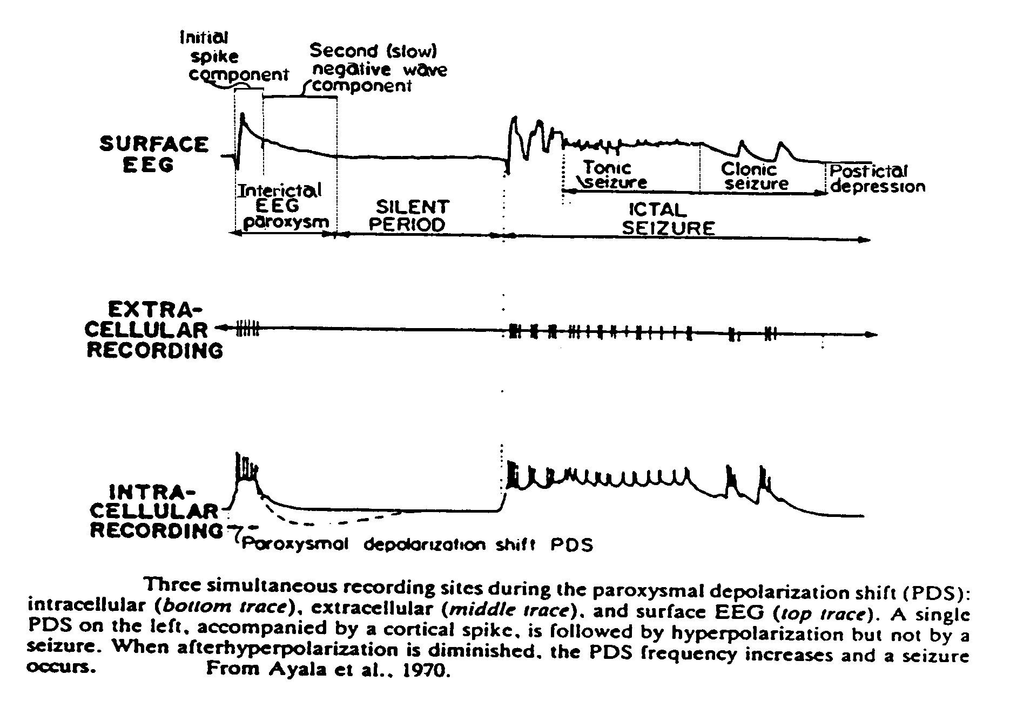
Neuronal Correlates of Paroxysmal Discharges

Slide 22
II. Generalized Seizures
B. Absence Seizures (Petite Mal)
Brief and abrupt loss of consciousness.
Sometimes with no motor manifestations.
Usually symmetrical clonic motor activity varying from occasional eyelid flutter to jerking of the entire body.
Typical 2.5 – 3.5 Hz spike-and-wave discharge.
Usually of short duration (5-10 sec), but may occur dozens of times a day.

Slide 23
II. Generalized Seizures
B. Absence Seizures (Petite Mal) (con’t)
Often begin during childhood (daydreaming attitude, no participation, lack of concentration).
A low threshold Ca²⁺ current has been found to govern oscillatory responses in thalamic neurons (pacemaker) and it is probably involve in the generation of these types of seizures.
EEG: Bilaterally synchronous, high voltage 3-per-second spike- and-wave discharge pattern.
spike phase: neurons generate short duration depolarization and a burst of action potentials. No sustained depolarization or repetitive firing.

Slide 24
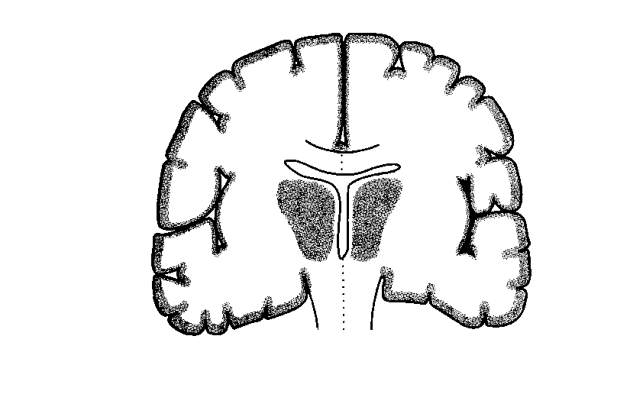
Scheme of Seizure Spread
Primary Generalized Absence Seizures
Thalamocortial relays are believed to act on a hyperexcitable
www.freelivedoctorc.coomrtex

Slide 25
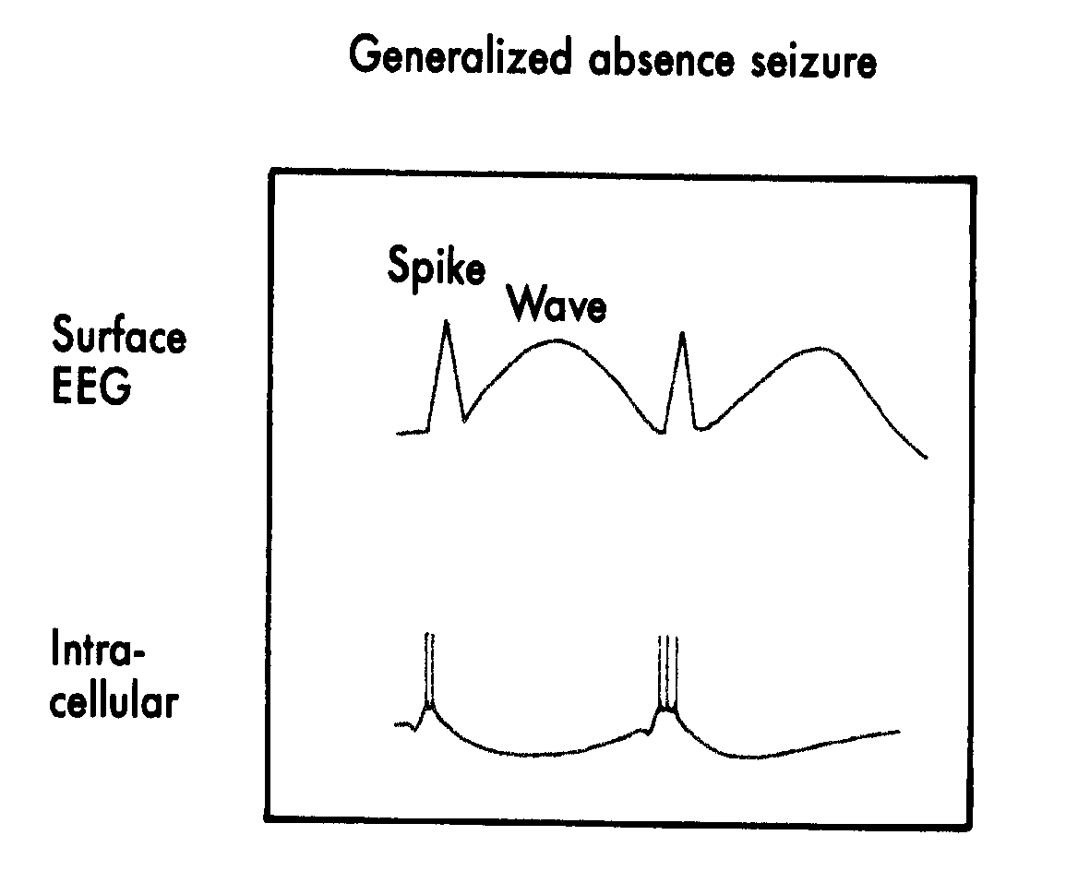
Neuronal Correlates of Paroxysmal Discharges
Generalized Absence Seizures

Slide 26




Scheme of Seizure Spread

Slide 27
II. Generalized Seizures (con’t)
C. Tonic Seizures
Opisthotonus, loss of consciousness.
Marked autonomic manifestations
D. Atonic Seizures (atypical)
Loss of postural tone, with sagging of the head or falling.
May loose consciousness.

Slide 28
II. Generalized Seizures (con’t)
E. Clonic and Myoclonic Seizures
Clonic Seizures: Rhythmic clonic contractions of all muscles, loss of consciousness, and marked autonomic manifestations.
Myoclonic Seizures: Isolated clonic jerks associated with brief bursts of multiple spikes in the EEG.
F. Infantile Spasms
An epileptic syndrome.
Attacks, although fragmentary, are often bilateral.
Characterized by brief recurrent myoclonic jerks of the body with sudden flexion or extension of the body and limbs.

Slide 29
Treatment of Seizures
Goals:
Block repetitive neuronal firing.
Block synchronization of neuronal discharges.
Block propagation of seizure.
Minimize side effects with the simplest drug
regimen.
MONOTHERAPY IS RECOMMENDED IN MOST CASES

Slide 30
Treatment of Seizures
Strategies:
Modification of ion conductances.
Increase inhibitory (GABAergic) transmission.
Decrease excitatory (glutamatergic) activity.

Slide 31



Actions of Phenytoin on Na⁺ Channels
Na⁺
B. Resting State
D. Arrival of Action Potential causes depolarization and channel opens allowing sodium to flow in.
Na⁺
F. Refractory State, Inactivation
Na⁺
Sustain channel in this conformation

Slide 32
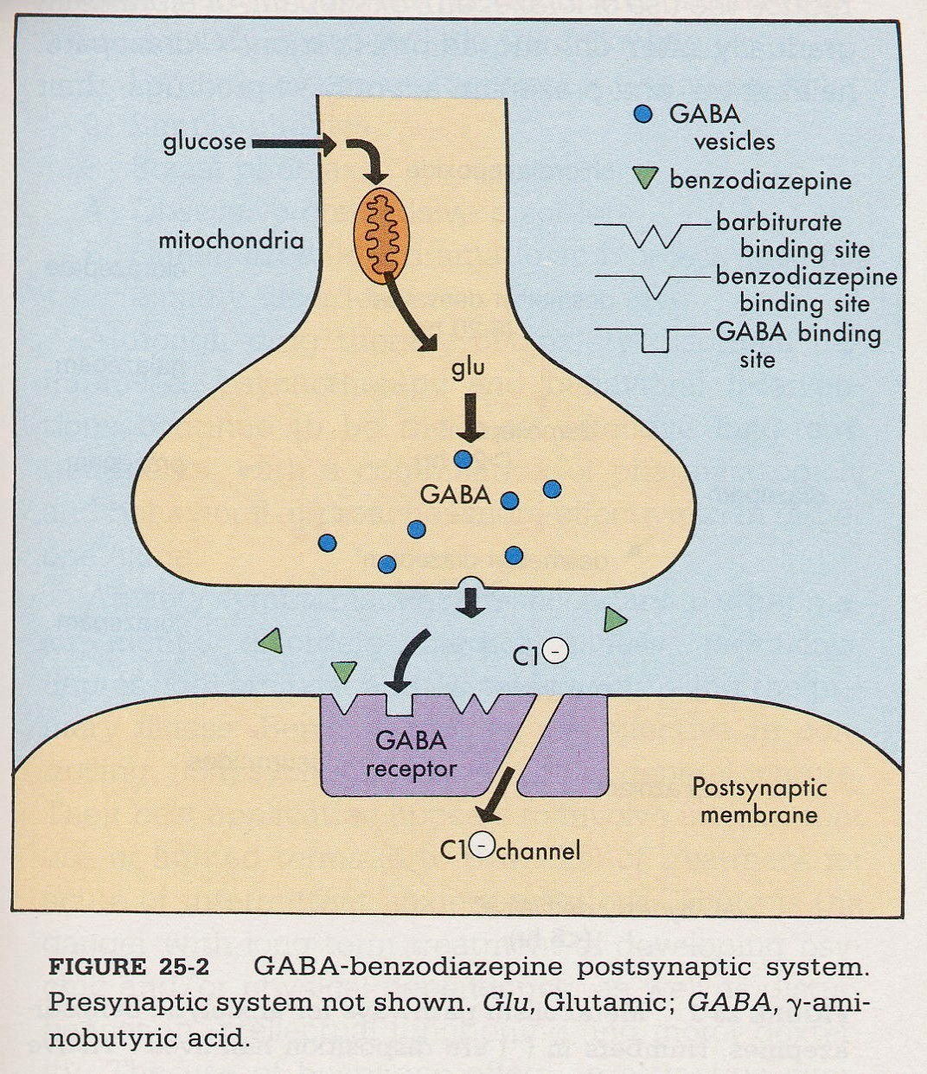

GABAergic SYNAPSE
Drugs that Act at the GABAergic Synapse
GABA agonists
GABA antagonists
Barbiturates
Benzodiazepines
GABA synthesizing enzymes
GABA uptake inhibitors
GABA metabolizing enzymes
GABA-T
GAD
GAT

Slide 33

GLUTAMATERGIC SYNAPSE
Excitatory Synapse.
Permeable to Na⁺, Ca²⁺ and K⁺.
Magnesium ions block channel in resting state.
Glycine (GLY) binding enhances the ability of GLU or NMDA to open the channel.
Agonists: NMDA, AMPA, Kianate.
Na⁺ _{Ca}2+
AGONISTS
GLU
GLY
_{Mg}++
_{K}+
www.freelivedoctor .com

Slide 34
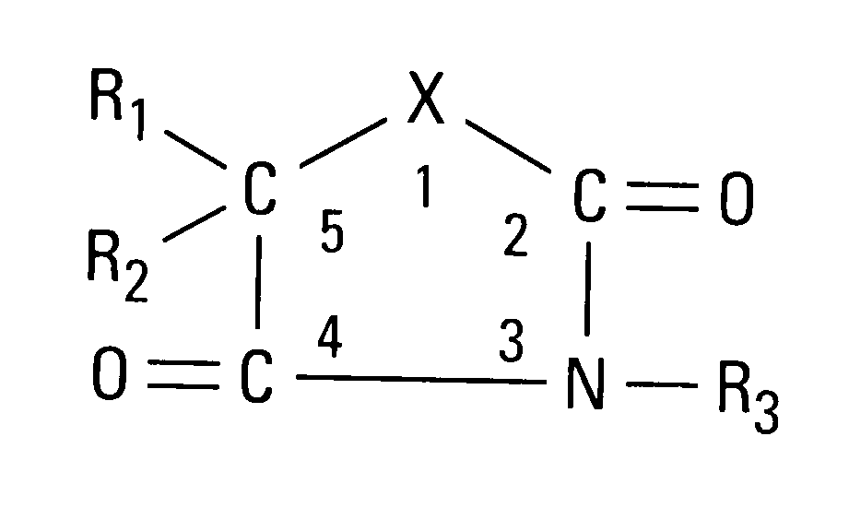
Chemical Structure of Classical Antiseizure Agents
X may vary as follows: Barbiturates Hydantoins
- C – N -
- N –
Oxazolidinediones – O –
Succinimides Acetylureas
– C –
- NH₂ –*
*(N connected to C2)
Small changes can alter clinical activity and site of action.
e.g. At R1, a phenyl group (phenytoin) confers activity against partial seizures, but an alkyl group (ethosuximide) c^{w}o^{w}n^{w}fe^{.f}r^{re}s^{e}a^{liv}c^{e}t^{d}iv^{oc}i^{t}tºy^{r .}a^{c}g^{om}ainst generalized absence seizures.

Slide 35
Treatment of Seizures
Hydantoins: phenytoin
Barbiturates: phenobarbital
Oxazolidinediones: trimethadione
Succinimides: ethosuximide
Acetylureas: phenacemide
Other: carbamazepine, lamotrigine, vigabatrin, etc.
Diet
Surgery, Vagus Nerve Stimulation (VNS).

Slide 36
Treatment of Seizures
Most classical antiepileptic drugs exhibit similar pharmacokinetic properties.
Good absorption (although most are sparingly soluble).
Low plasma protein binding (except for phenytoin, BDZs, valproate, and tiagabine).
Conversion to active metabolites (carbamazepine, primidone, fosphenytoin).
Cleared by the liver but with low extraction ratios.
Distributed in total body water.
Plasma clearance is slow.
At high concentrations phenytoin exhibits zero order kinetics.

Slide 37
Treatment of Seizures
Structurally dissimilar drugs:
Carbamazepine
Valproic acid
BDZs.
New compounds:
Felbamate (Japan)
Gabapentin
Lamotrigine
Tiagabine
Topiramate
Vigabatrin

Slide 38
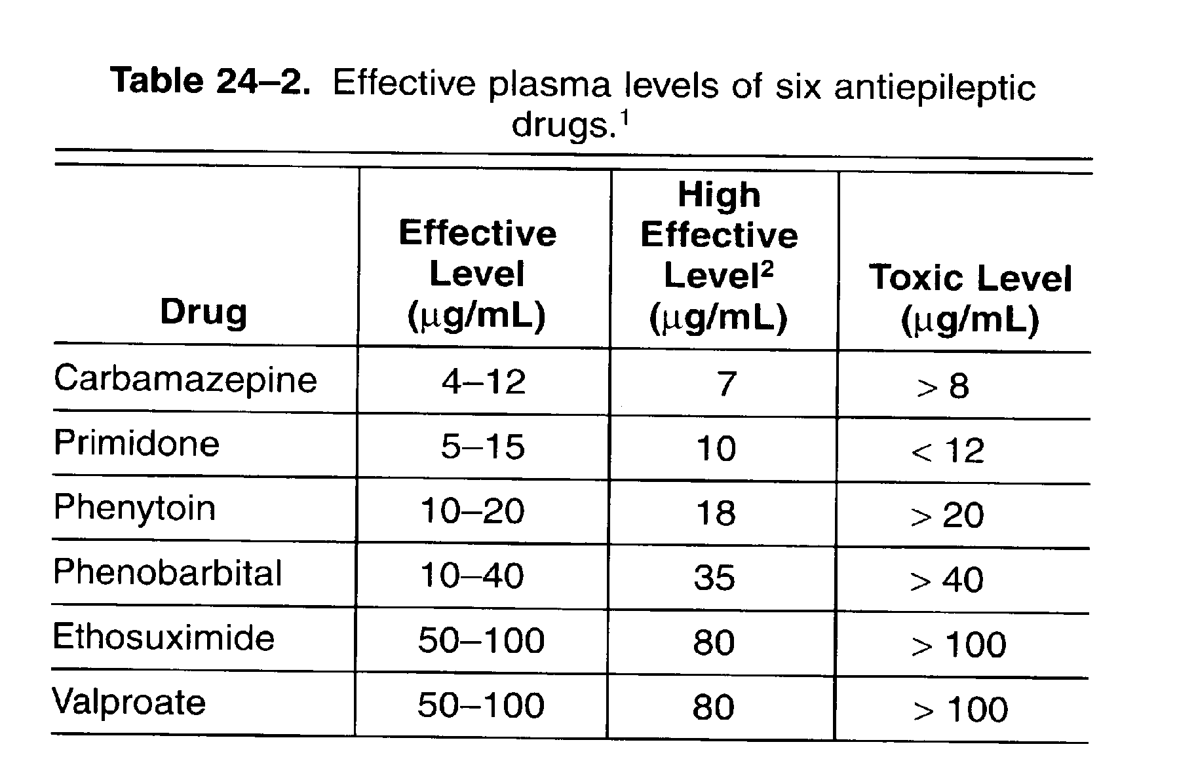
Pharmacokinetic Parameters

Slide 39
Table I. Pharmacokinetics of Selected Anticonvulsants
AGENT
Barbiturates
Phenobarbital
Route Onset
Peak
Duration
PB(%)
t½
BioA (%)
po
20-60 min
20-60 min
20-60 min
20-60 min
20-60 min
6-12 hr UK
6-12 hr
4-6 hr
40-60
40-60
40-60
40-60
19-25
37-104 hr
Varies
UA UA
IM
SC IV
15-30 min
3-4 hr
4-10 hr
8-12 hr
11-67 hr
5-15 hr
10-18 hr (PEMA)
100
60-80
Primdone
po
Benzodiazepines Clonazepam Diazepam
po po IV
20-60 min
30-60 min Immediate
1-4hr 0.5-2hr
15-30 min
6-12 hr
2-3 hr
20-60 min
50-85
18-50 hr
20-100 min
20-100 hr
14-16 hr
80-98
UA 100
83-100
96-99
85-99
85
Lorazepam
po
1-5 min
1-6hr
6-8 hr
Hydantoins
Phenytoin
po
2-24 hr
1.5-3 hr
4-12 hr* Rapid
6-12hr 12-36 hr* UA
87-95
6-42 hr
10-90
90
(shorter in children) 24-30 hr
IV
1-2 hr
20-90
Oxazolidinediones
Trimethadione
po
UA
0.5-2 hr
UA
0
12-24 hr
6-13 days (metabolite)
UA
Succinimides
Ethosuxamide
po
hours
1-4 hr
3-7 hr
>24hr
0-10
40-60 hr (AD)
30 hr (CH)
UA
Miscellaneous Carbamazepine Gabapentin Zonisamide Vigabatrin Topiramate Lamotrigine
po po po po po po
2-4 days Rapid UK
UK UK UK
2-4 hr
2-4 hr UK UK UK
1.4 hr
UK
8 hr UK UK UK UK
75-90
0-3
UK UK UK 55
25-29 hr
5-7 hr
1-3 days
6-8 hr
20-30 hr
24-30 hr
85
50-60
UA 60
80
98-100
PB: protein binding, t ½: half-life, BioA: bioavailability, po: oral, IM: intramuscular, IV, intravenous, SC: subcutaneous, UA: unavailable, UK: unknown,
PEMA: phenylethylmalonamide, AD: Adult, CH: Children.
www.freelivedoctor .com

Slide 40
Table 3. Interaction of Antiseizure Drugs with Hepatic Microsomal Enzymes
 | Induces | Induces | Inhibits | Inhibits | Metabolized | Metabolized
Drug | CYP | UGT | CYP | UGT | BY CYP | BY UGT
Carbamazepine
2C9;3A Yes
1A2;2C8;
2C9; |  | 3A4
No
families
Ehosuxamide Gabapentin Lamotrigine Levetiracetam Oxcarbazepine Phenobarbital
No
No No No No Yes Yes
No No No No 2C19
No No No No Weak No
Uncertain No
No No No
2C9;2C19
Uncertain No
Yes No Yes No
No No No
3A4/5 2C;3A
families 2C;3A
families 2C;3A
families No
Yes
Phenytoin
Yes
Yes
No
2C9;2C19
No
Primidone
Yes
Yes
No
2C9;2C19
No
Tiagabine Topiramate Valproate Zonisamide
No No No No
No 2C19
No No Yes No
3A4
No
No No No
2C9
2C9;2C19
Yes Yes
No
3A4
CYP; cytochrome P450. UGT, UDP-glucuronosyltransferase Reference: Anderson, 1998
www.freelivedoctor .com

Slide 41
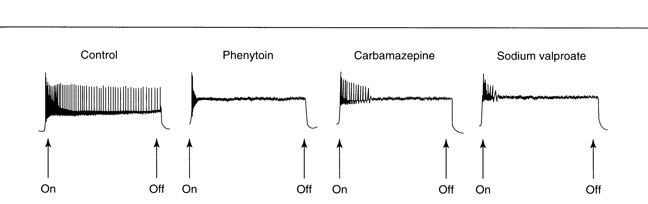
Effects of three antiepileptic drugs on high frequency discharge of cultured neurons
.
Block of sustained high frequency repetitive firing of action potentials.
www.freelivedoctor .com
(From Katzung B.G., 2001)

Slide 42
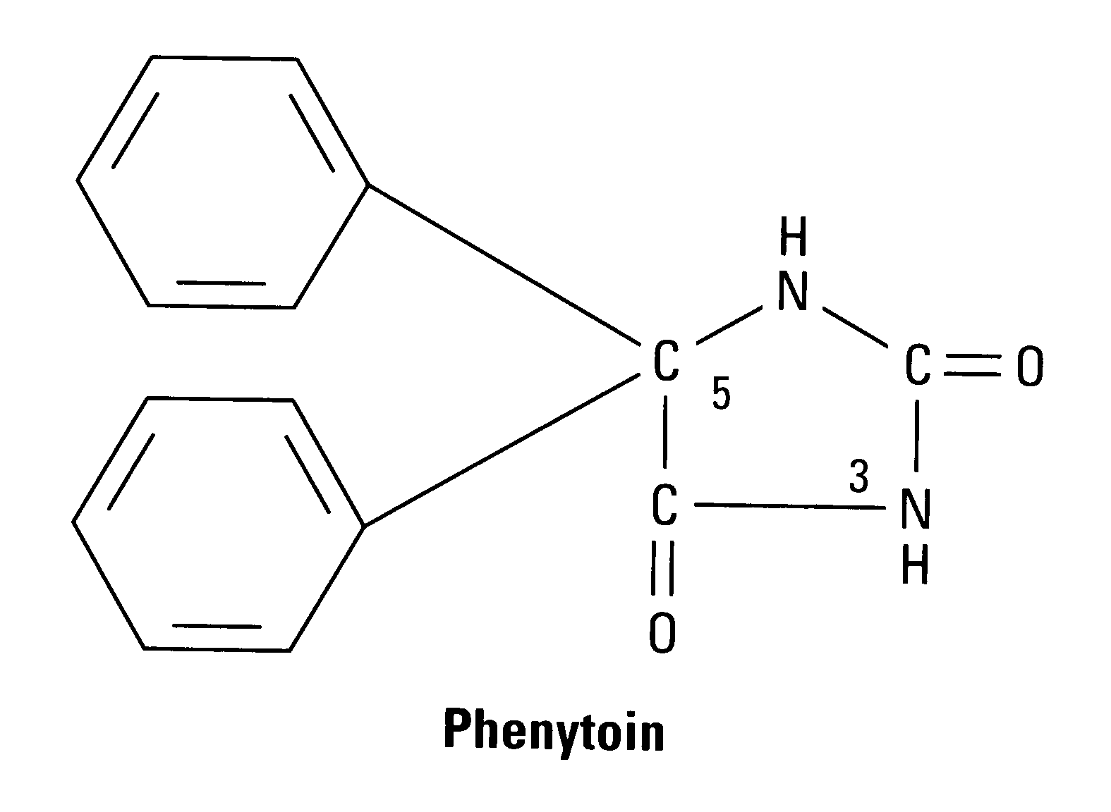
PHENYTOIN (Dilantin)
Oldest nonsedative antiepileptic drug.
Fosphenytoin, a more soluble prodrug is used for parenteral use.
“Fetal hydantoin syndrome”.
Manufacturers and preparations.
It alters Na⁺, Ca²+ and K⁺ conductances.
Inhibits high frequency repetitive firing.
Alters membrane potentials.
Alters a.a. concentration.
Alters NTs (NE, ACh, GABA)
Toxicity:
Ataxia and nystagmus.
Cognitive impairment.
Hirsutism
Gingival hyperplasia.
•Coarsening of facial features. •
Dose-dependent zero order kinetics.
Exacerbates absence seizures.
At high concentrations it causes a type of decerebrate rigidity.

Slide 43
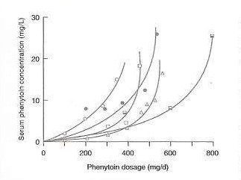
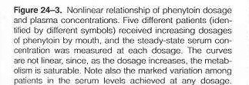

Slide 44
CARBAMAZEPINE (Tegretol)
Tricyclic, antidepressant (bipolar)
3-D conformation similar to phenytoin.
Mechanism of action, similar to phenytoin. Inhibits high frequency repetitive firing.
Decreases synaptic activity
Toxicity:
presynaptically.
Binds to adenosine receptors (?).
Inh. uptake and release of NE, but not GABA.
Autoinduction of metabolism.
Nausea and visual disturbances.
Granulocyte supression•.
Aplastic anemia.
Potentiates postsynaptic effects of GABA.
Exacerbates absence seizures.
Metabolite is active.
www.freelivedoctor .com

Slide 45
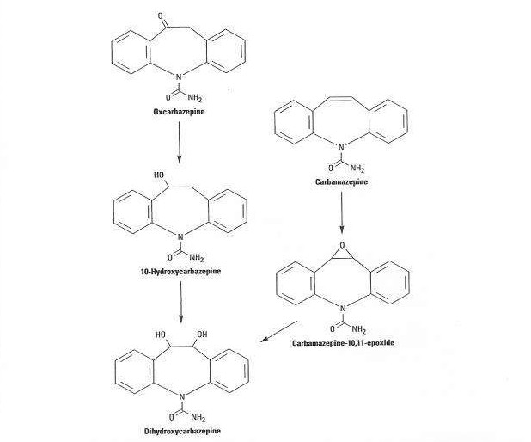

Slide 46
OXCARBAZEPINE (Trileptal)
Closely related to carbamazepine.
With improved toxicity profile.
Less potent than carbamazepine.
Active metabolite.
Use in partial and generalized
Toxicity:
Hyponatremia
Less hypersensitivity and induction of hepatic enzymes than with carbamazepine
seizures as adjunct therapy.
May aggravate myoclonic and absence seizures.
Mechanism of action, similar to carbamazepine It alters Na⁺ conductance and inhibits high frequency repetitive firing.

Slide 47
PHENOBARBITAL (Luminal)
Except for the bromides, it is the oldest antiepileptic drug.
Although considered one of the safest drugs, it has sedative effects.
Many consider them the drugs of choice for seizures only in infants.
Acid-base balance important.
Useful for partial, generalized tonic-
Toxicity:
Sedation.
Cognitive
impairment.
clonic seizures, and febrile seizures
•
Behavioral changes. • Prolongs opening of Cl⁻ channels.
Induction of liver
Blocks excitatory GLU (AMPA)
enzymes.
responses. Blocks Ca²⁺ currents (L,N).
Inhibits high frequency, repetitive firing of neurons only at high concentrations.
May worsen absence
and atonic seizures.

Slide 48
PRIMIDONE (Mysolin)
Metabolized to phenobarbital and phenylethylmalonamide (PEMA), both active metabolites.
Effective against partial and generalized tonic-clonic seizures.
Absorbed completely, low binding to plasma proteins.
Toxicity:
Should be started slowly to avoid sedation and GI problems.
Same as phenobarbital
Sedation occurs early.
Gastrointestinal complaints. • Its mechanism of action may be
closer to phenytoin than the
barbiturates.

Slide 49
VALPROATE (Depakene)
Fully ionized at body pH, thus active form is valproate ion.
One of a series of carboxylic acids with antiepileptic activity. Its amides and esters are also active.
Toxicity:
Elevated liver enzymes including own.
Nausea and vomiting.
Abdominal pain and heartburn.
Tremor, hair loss,
Weight gain.
Idiosyncratic
hepatotoxicity.
Mechanism of action, phenytoin.
∀ ⇑ levels of GABA in brain.
similar to
Facilitates Glutamic acid decarboxylase (GAD).
Inhibits the GABA-transporter in neurons and glia (GAT).
∀ ⇓ [aspartate]_{Brain}?
•Negative interactions with•
May increase membrane potassium
other antiepileptics.
Teratogen: spina bifida
conductance.
www.freelivedoctor .com

Slide 50
ETHOSUXIMIDE (Zarontin)
Drug of choice for absence seizures.
High efficacy and safety.
VD = TBW.
Not plasma protein or fat binding
Mechanism of action involves
Toxicity:
reducing low-threshold Ca²⁺ channel
Gastric distress,
current (T-type channel) in thalamus.
including, pain, nause_{A}a _{t high concentrations:}
and vomiting
Lethargy and fatigue
Headache
Hiccups
Euphoria
Skin rashes
Inhibits Na⁺/K⁺ ATPase.
Depresses cerebral metabolic rate.
Inhibits GABA aminotransferase.
  Phensuximide = less effective
Methsuximide = more toxic
www.freelivedoctor .com
Lupus erythematosus (?)

Slide 51
CLONAZEPAM (Klonopin)
A benzodiazepine.
Long acting drug with efficacy for absence seizures.
One of the most potent antiepileptic agents known.
Also effective in some cases of myoclonic seizures.
Toxicity:
Sedation is prominent.
Ataxia.
Behavior disorders.
Has been tried in infantile spasms.
Doses should start small.
Increases the frequency of Cl⁻ channel opening.

Slide 52
VIGABATRIN (γ-vinyl-GABA)
Absorption is rapid, bioavailability is ~ 60%, T _{1/2} 6-8 hrs, eliminated by the kidneys.
Use for partial seizures and West’s syndrome.
Contraindicated if preexisting mental illness is present.
Irreversible inhibitor of GABA- aminotransferase (enzyme responsible for metabolism of GABA) => Increases inhibitory effects of GABA.
S(+) enantiomer is active.
Toxicity:
Drowsiness
Dizziness
Weight gain
Agitation
Confusion
Psychosis

Slide 53
LAMOTRIGINE (Lamictal)
Add-on therapy with valproic acid (w/v.a. conc. have be reduced => reduced clearance).
Almost completely absorbed
T_{1/2} = 24 hrs
Low plasma protein binding
Effective in myoclonic and generalized seizures in childhood and absence attacks.
Involves blockade of repetitive firing
Toxicity:
Dizziness
Headache
Diplopia
Nausea
Somnolence
involving Na channels, like phenytoin.
Life threatening
rash “Stevens- Johnson”
Also effective in myoclonic and generalized seizures in childhood and absencwewwa.frtetealivcedkocsto.r .com

Slide 54
FELBAMATE (Felbatrol)
Effective against partial seizures but has severe side effects.
Because of its severe side effects, it has been relegated to a third-line drug used only for refractory cases.
Toxicity:
Aplastic anemia
Severe hepatitis

Slide 55
TOPIRAMATE (Topamax)
Rapidly absorbed, bioav. is > 80%, has no active metabolites, excreted in urine.T_{1/2} = 20-30 hrs
Blocks repetitive firing of cultured neurons, thus its mechanism may involve blocking of voltage-dependent sodium channels
Potentiates inhibitory effects of GABA (acting at a site different from BDZs and BARBs).
Depresses excitatory action of kainate on AMPA receptors.
Teratogenic in animal models.
Toxicity:
Somnolence
Fatigue
Dizziness
Cognitive slowing
Paresthesias
Nervousness
Confusion
Weak carbonic anhydrase inhibitor
Urolithiasis

Slide 56
TIAGABINE (Gabatril)
Derivative of nipecotic acid.
100% bioavailable, highly protein bound.
T_{1/2} = 5 -8 hrs
Effective against partial seizures in pts at least 12 years old.
Approved as adjunctive therapy.
GABA uptake inhibitor γ aminibutyric acid transporter (GAT) by neurons and glial cells.
Toxicity:
Abdominal pain and nausea (must be taken w/food)
Dizziness
Nervousness
Tremor
Difficulty concentrating
Depression
Asthenia
Emotional liability
Psychosis
Skin rash
www.freelivedoctor .com

Slide 57
ZONISAMIDE (Zonegran)
Marketed in Japan. Sulfonamide derivative. Good bioavailability, low pb.
T_{1/2} = 1 - 3 days
Effective against partial and generalized tonic-clonic seizures.
Approved by FDA as adjunctive therapy in adults.
Mechanism of action involves voltage and use-dependent inactivation of sodium channels.
Inhibition of Ca²⁺ T-channels.
Binds GABA receptors
Facilitates 5-HT and DA
Toxicity:
Drowsiness
Cognitive impairment
Anorexia
Nausea
High incidence of renal stones (mild anhydrase inh.).
Metabolized by CYP3A4
neurotransmission
www.freelivedoctor .com

Slide 58
GABAPENTIN (Neurontin)
Used as an adjunct in partial and generalized tonic-clonic seizures.
Does not induce liver enzymes.
not bound to plasma proteins.
drug-drug interactions are negligible.
Toxicity:
Somnolence.
Dizziness.
Ataxia.
Headache.
Tremor.
Low potency.
An a.a.. Analog of GABA that does not act on GABA receptors, it may however alter its metabolism, non- synaptic release and transport.

Slide 59
Status Epilepticus
Status epilepticus exists when seizures recur within a short period of time , such that baseline consciousness is not regained between the seizures. They last for at least 30 minutes. Can lead to systemic hypoxia, acidemia, hyperpyrexia, cardiovascular collapse, and renal shutdown.
The most common, generalized tonic-clonic status epilepticus is life-threatening and must be treated immediately with concomitant cardiovascular, respiratory and metabolic management.

Slide 60
Treatment of Status Epilepticus in Adults
Initial
Diazepam, i.v. 5-10 mg (1-2 mg/min) repeat dose (5-10 mg) every 20-30 min.
Lorazepam, i.v. 2-6 mg (1 mg/min)
repeat dose (2-6 mg) every 20-30 min.
Follow-up
Phenytoin, i.v. 15-20 mg/Kg (30-50 mg/min). repeat dose (100-150 mg) every 30 min.
Phenobarbital, i.v. 10-20 mg/Kg (25-30mg/min). repeat dose (120-240 mg) every 20 min.

Slide 61
DIAZEPAM (Valium) AND LORAZEPAM (Ativan)
Benzodiazepines.
Will also be discussed with Sedative hypnotics.
Given I.V.
Toxicity
Sedation
Lorazepam may be longer acting.
1° for treating status epilepticus
Have muscle relaxant activity.
Allosteric modulators of GABA receptors.
Potentiate GABA function by increasing the frequency of channel opening.
Children may manifest a paradoxical hyperactivity.
Tolerance

Slide 62
Treatment of Seizures
PARTIAL SEIZURES ( Simple and Complex, including secondarily generalized)
Drugs of choice: Carbamazepine
Phenytoin
Valproate
Alternatives: Lamotrigine, phenobarbital, primidone, oxcarbamazepine.
Add-on therapy: Gabapentin, topiramate, tiagabine, levetiracetam, zonisamide.

Slide 63
Treatment of Seizures
PRIMARY GENERALIZED TONIC-CLONIC
SEIZURES (Grand Mal)
Drugs of choice: Carbamazepine
Phenytoin
Valproate*
Alternatives: Lamotrigine, phenobarbital, topiramate, oxcartbazepine, primidone, levetiracetam.
*Not approved except if absence seizure is involved

Slide 64
Treatment of Seizures
GENERALIZED ABSENCE SEIZURES
Drugs of choice: Ethosuximide
Valproate*
Alternatives: Lamotrigine, clonazepam, zonisamide, topiramate (?).
* First choice if primary generalized tonic-clonic seizure is also present.

Slide 65
Treatment of Seizures
ATYPICAL ABSENCE, MYOCLONIC, ATONIC* SEIZURES
Drugs of choice:
Valproate Clonazepam Lamotrigine**
Alternatives: Topiramate, clonazepam, zonisamide, felbamate.
* Often refractory to medications.
**Not FDA approved for this indication. May worsen myoclonus.

Slide 66
Treatment of Seizures
INFANTILE SPASMS
Drugs of choice: Corticotropin (IM) or
Corticosteroids (Prednisone)
Zonisamide
Alternatives: Clonazepam, nitrazepam, vigabatrin, phenobarbital.

Slide 67
Treatment of Seizures in Pregnancy
Phenytoin Carbamazepine
Phenobarbital Primidone
They may all cause hemorrhage in the infant due to vitamin K deficiency, requiring treatment of mother and newborn.
They all have risks of congenital anomalies (oral cleft, cardiac and neural tube defects).
Teratogens:
Valproic acid causes spina bifida.
Topiramate causes limb agenesis in
rodents and hypospadias in male infants.
Zonisamide is teratogenic in animals.

Slide 68
INTERACTIONS BETWEEN ANTISEIZURE DRUGS
With other antiepileptic Drugs:
- Carbamazepine with
phenytoin phenobarbital
Increased metabolism of carbamazepine Increased metabolism of epoxide.
- Phenytoin with primidone
Increased conversion to phenobarbital.
- Valproic acid with clonazepam
May precipitate nonconvulsive status epilepticus
Decrease metabolism, increase toxicity. Displacement from binding, increase toxicity.
phenobarbital phenytoin

Slide 69
ANTISEIZURE DRUG INTERACTIONS
With other drugs: antibiotics anticoagulants
cimetidine isoniazid
oral contraceptives salicylates theophyline
↑ phenytoin, phenobarb, carb.
phenytoin and phenobarb↑ met.
displaces pheny, v.a. and BDZs
↑ toxicity of phenytoin antiepileptics ↑ metabolism. displaces phenytoin and v.a.
carb and phenytoin may↓ effect.

Slide 70
Table 2. Proposed Mechanisms of Antiepileptic Drug Action
 | ↓Na+ channels | ↓Ca+ channels | ↓K+ channels | ↑ Inh. transmission | ↓Excitatory transmission
Established AED’s PHT | +++
CBZ ESM | +++ | +++
PB BZD’s VPA | + | + + |  | +++ +++ ++ | + +
New AED’s LTG | +++ | +
OXC | +++ | + | +
ZNS VGB | ++ | ++ |  | +++
TGB |  |  |  | +++
GBP | + | + |  | ++
FBM | ++ | ++ |  | ++ | ++
TPM | ++ | ++ |  | ++ | ++
LEV |  | + |  | + | +
+++ primary action, ++ possible action, + probable action.
From P. Kwan et al. (2001) Pharmacology an_{w}d_{w}th_{w}e.r_{f}a_{re}p_{e}e_{l}u_{iv}ti_{e}c_{d}s_{o}9_{c}0_{to}:2_{r}1.-_{c}3_{o}4_{m}. [Data from Upton (1994), Schachter (1995), McDonald and Kelly (1995), Meldrum (1996), Coulter (1997), and White (1999).]

